Slide 1
Global Leadership Fellows Forum 01: On Peace
Juichiro Tanabe

Slide 2
Structure of the class
1) Negative peace and positive peace
2) Conflict dynamics and peace
3) Key concepts pertinent to peace: peacemaking, peacekeeping, and peacebuilding
4) Linda Groff’s models of peace

Slide 3
Peace
★No single definition of peace
➡Having multiple meanings: A subjective or intersubjective concept defined distinctively by different individuals/groups
➡A contested concept with no fixed meaning
★Peace: Constructed by human beings
➡Its meaning changes according to different social and cultural situations and environments

Slide 4
Peace
◎Three aspects of peace (Suggested by Linda Groff – an American peace scholar and futurologist)
①Peace as goal(s)/vision(s): What kind(s) of peace we want to achieve
②Peace as means/processes used to realize the goals/visions
➡Negotiation, mediation, arbitration, dialogue, reconciliation, (peace) education, military intervention, development, art, sports, etc.
③Peace as feeling: How do we feel when we are peaceful? How do we feel when we have achieved what we envisioned as peace?

Slide 5
Peace
◎Public peace and private peace
Public peace: Peace in public spheres/relations
➡Inter-communal peace, inter-state peace, international peace, peace within a community, peace within a state, etc.
➡Maintenance of social order/stability
Private peace: Peace in private spheres
➡Inner peace (serenity), peace within a family, peace with close friends, etc.

Slide 6
Peace
★Possible clash between public peace and private peace
Public peace: Maintaining social order: Existing unequal social structure or undemocratic system could be included
➡This could clash with citizens whose private peace means to change the existing structure – political and economic – to redress unequal access to basic human needs
★Public peace: Not necessarily secure and consolidate private peace in some contexts
➡Myanmar (between military authority and citizens), Putin’s repression of Russian citizens who are opposed to the war in Ukraine,
➡What do you think?

Slide 7
Negative peace and positive peace
Negative peace and positive peace: proposed by Johan Galtung
➡Contributed to developing Peace and Conflict Studies
◎Negative peace: A narrow version of peace and short-term oriented approach to peace
➡An absence of direct/overt violence between/within states, between individuals, between/within communities
➡Ceasefire agreement, provisional power-sharing agreement, control of violence by coercion or threat of force, authoritarian rule to suppress violence in society, etc.

Slide 8
Negative peace
★An inherent view of conflict: Violence = intrinsic to part of human nature as a biological being
➡Violence: Endemic in human history, society, and international relations
➡Violence/conflict: Rooted in human nature
➡Use of force or coercion as the practical method to suppress and control violence/conflict
★The preservation of a pre-existing order/monitoring the status quo by force or coercion

Slide 9
Negative peace
◎The Cold War
◎Balance of power and maintenance of the balance to avoid the recourse to war: US-China relationship?
◎Political confrontation but without recourse to violent conflict: Korea-Japan relation?
★To keep the status quo without relational and structural transformation
★Unfortunately, even negative peace was broken in Ukrainian crises after the Russian invasion…

Slide 10
Positive peace
◎A broader view of peace
★Peace as an elimination of structural violence
➡Idea of Sufficiency Economy in Thailand and Human Security
★Peace as a participatory political system
➡Establishment of deliberative and dialogical politics
★Peace as a restoration of broken human relationships between former enemies
➡Truth and Reconciliation Commission in South Africa
★Peace as a construction of society that respects human rights of all citizens beyond ethnic, religious, or cultural differences

Slide 11
Positive peace
★Critique of pessimistic view of human nature
Cause of conflict/violence ≠ Inherent aggressive, violent and egoistic nature of human beings
➡Causes of conflict: multiple causes – social, political, economic, psychological, etc.
Conflict (especially armed conflict): Being learned rather than innate in human society
Conflict: Can be mutually and consensually resolved by human beings

Slide 12
Positive peace
Optimistic view of human beings
➡Human beings: Having the capacity to understand why conflict arises and to produce a range of innovative approaches to conflict
➡Compromise, agreement, institutional reform, redistribution of resources, reconciliation, education, etc.
★Human beings: Inherently possessing the capacity and skills to learn new knowledge and modify the learned knowledge creatively to resolve problems facing us

Slide 13
Positive peace
◎Critique of positive peace
➡The concept too broad to be achieved: “Anything goes” orientation
◎Response from positive peace
➡While appreciating the critique, humanity has practiced variety of peace that can be understood as positive peace
➡Post-conflict/war human reconciliation (South Africa, Rwanda, etc.,); Concepts of sustainable development, and human security; practices of peace education in Northern Ireland, in Palestine/Israel, and other countries
➡Need to offer concrete ideas of positive peace in different contexts
➡We can be creative in producing contextually-oriented positive peace in many societies

Slide 14
Dilemma of negative peace and positive peace
★Order, justice (especially social justice), and peace
➡The status quo vs social change
Negative peace: Peace for elites, existing government, or those in power ➡Oriented to maintaining existing order/status quo
Positive peace: Peace for people/citizens, the marginalized, the underprivileged : Social reform included
★The meaning of peace differs according to people in different social, political, or economic positions
➡Different peace(s) can clash or contradict each other in one society or country

Slide 15
Complementarity between negative peace and positive in conflict dynamics
Conflict: Dynamic process with different stages/levels of tension
➡ABC Triangle: Changing constantly in conflict dynamics – both negatively and positively
➡Different stages and levels of tension: Requiring distinct approaches to peace
➡Different stages and levels of tension: Needs respectively different peace

Slide 16
Conflict: ABC Triangle
Contradiction
Behavior
Attitude

Slide 17
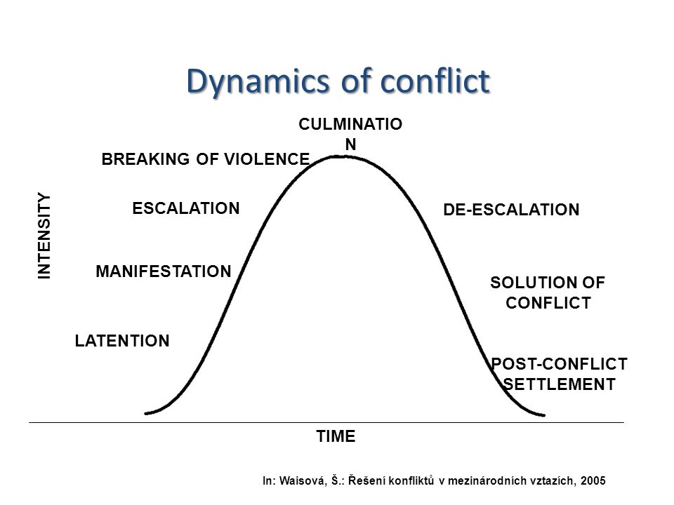

Slide 18
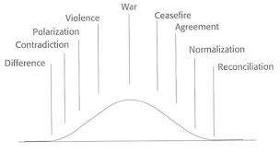

Slide 19
Conflict dynamics, negative peace and positive peace
★Low intensity
➡Negotiation, mediation, arbitration, problem-solving workshop, etc.
➡The aim: To prevent non-violent conflict from escalating into violent one and resolve the conflict peacefully
★Mid intensity
➡Power mediation: Mediation with third-party having coercive power
★High intensity: Break of violence
➡Power mediation, negotiation or military intervention if necessary

Slide 20
Conflict dynamics, negative peace and positive peace
◎De-escalation stage
➡Ceasefire agreement
➡Imposition of peacekeeping force to monitor the ceasefire and prevent the resurgence of violence
➡Problem-solving workshop to exchange opinions and explore mutually cooperative solutions
➡Reconciliation: Restoring broken relationship and building constructive community that can manage conflict peacefully and creatively in future

Slide 21
Conflict dynamics, negative peace and positive peace
★Implementation of positive peace: Requires negative peace pragmatically
➡Violent conflict: Positive peace cannot be carried out without securing negative peace
➡Need to understand negative peace and positive peace as a continuum
★Of course, conflict and peace are not so simple as shown by the dynamics model.
➡So, our flexibility and creativity required to respond to real conflict properly…

Slide 22
Peace for Ukraine from negative peace and positive peace perspectives
◎Negative peace (short and mid-term peace) : Ceasefire agreement between Ukraine and Russia
➡The urgent matter
➡Provision of humanitarian assistance for Ukrainian citizens
◎Between negative peace and positive peace
➡Repatriation of Ukrainian citizens and/or support of long-term settle down in other countries if they want
➡Continuous negotiation between Ukraine, Russia, and the West over the future status of Ukraine

Slide 23
Peace for Ukraine from negative peace and positive peace perspectives
◎Positive peace (long-term peace) : Micro and macro levels
➡Socio-economic reconstruction of the Ukraine
➡Trauma care for the Ukrainian citizens
➡Continuous dialogue between Ukrainian citizens and pro-Russian citizens
➡Establishment of minimum cooperative arrangement between Russia and the West: Guaranteeing no further NATO’s eastward expansion and stable provision of natural gas to European countries by Russia
➡Securing neutral status of Ukraine and building new security regime that entails Ukraine, Russia, EU, and the US and regional countries to create wider security system
★What about the investigation of reported gross human rights violations by Russian troops?

Slide 24
Other key words related to peace
①Peacemaking
An approach seeking to bring parties to conflict to a ceasefire agreement by peaceful means – negotiation, mediation, or conciliation
➡Building negative peace
②Peacekeeping
The imposition of international armed forces to separate the parties to conflict and monitor and support humanitarian assistance delivery and help parties in conflict proceed to concrete political deal

Slide 25
Other key words related to peace
Peacekeeping
Established in 1956 by the UN: UNEF I (United Nations Emergency Force in Egyptian territory)
Dispatched following the ceasefire agreement and consent from parties to conflict
Main mission: To prevent the re-eruption of armed conflict and oversee the implementation of a political settlement
➡To keep negative peace so that positive peace can be discussed and practiced
★Peacekeeping itself does not address the causes of conflict and achieve positive peace

Slide 26
Other key words related to peace
③Peacebuilding
An approach to peace that underpins peacemaking and peacekeeping by addressing social, political, and economic structures that cause conflict and build a constructive relationship between/among parties to conflict
➡A holistic approach to build positive peace in the post-conflict nation/society to prevent a relapse into violent conflict and create a sustainable society

Slide 27
Other key words related to peace
Peacebuilding
Origin: (1)Agenda for Peace (1992) by UN Secretary-General Boutros Ghali: Post-conflict peacebuilding – to demobilize conflictants and hold multi-party election and establish democratic system
(2) Supplement to An Agenda for Peace (1995) by Boutros-Ghali: Extended the scope of peacebuilding by adding humanitarian, economic, and political areas besides demobilization of combatants and multi-party election
The roles of external actors – International Organizations, NGOs, states, etc. – emphasized in carrying out peacebuilding

Slide 28
Linda Groff’s models of peace for future
(1) Feminist peace: Elimination of physical, structural and cultural violence on both micro (community, family and individual) levels and macro (state, inter-state, and international levels) and patriarchal values, attitudes and organizations that block people’s opportunities
➡ Gender awareness campaign/raising awareness campaign
➡ Gender education
➡Issues of gender and cultural relativity need to be discussed
➡Can feminist view be a universal value or is it an Western one?

Slide 29
Linda Groff’s models of peace for future
(2) Intercultural peace: Peace between/among diverse cultures, civilizations and religions
➡Need for mutual understanding and co-existence in increasing interaction of variety of values, norms, lifestyles
➡Appreciating the rich cultural diversity of humanity as an essential component of a more harmonious and humane multicultural world
★What can we do to promote intercultural peace on both micro and macro levels??

Slide 30
Linda Groff’s models of peace for future
Intercultural peace
Students’ exchange program: High school and junior high school education program
➡Kenneth Boulding advocated the exchange program as a key to sustainable peace in early 1970s
Multicultural education/workshops
Community projects

Slide 31
Linda Groff’s models of peace for future
(3) Holistic Gaia peace: Peace between human beings and the planetary environment
➡Peace between human beings and the Earth and all diverse ecological system and species
➡The recognition of the Earth as a complex, self-organizing living system or humans as part of that
➡Sustainable development and SDGs (Sustainable Development Goals)
★How can we promote holistic Gaia peace from our daily lives?

Slide 32
Linda Groff’s models of peace for future
Holistic Gaia peace
Inter-governmental level: To strengthen international environmental agreement like Paris Agreement and consolidate enforcement mechanisms
Civil level: Promotion of environmental education; community project (to practice SDGs); change lifestyle?

Slide 33
Linda Groff’s models of peace for future
(4) Holistic inner and outer peace
➡Mixture of socio-political and economic peace and human internal peace
➡Religious peace: Promoting human inner enrichment for transformation: Compassion, mercy, touching divinity (God), etc..
★Many religions also preach social justice as part of peace

Slide 34
Linda Groff’s models of peace for future
Holistic inner and outer peace
➡ Individual level: The practice of mindfulness, meditation
➡ Public level: Education - Peace education, transformative education, holistic education; enrichment of deliberative democracy?

Slide 35
Conclusion
★Peace: Complex and multi-dimensional process
★Different meanings and understandings of peace can clash in some cases
★Positive peace: Need for providing concrete and viable ideas according to different circumstances
★Though positive peace invites critique for its ambiguity, it can also empower us to be creative
★What kind(s) of peace do you want to achieve?
★What peace do you believe we should build in our contemporary world?

Slide 36
Recommended books and article
1) Galtung, Johan. (1996) Peace By Peaceful Means: Peace and Conflict, Development and Civilization. SAGE: London.
2) Groff, Linda. (2008) “Contributions of Different Cultural-Religious Traditions on Different Aspects of Peace – Learning to a Holistic, Integrative View of Peace for a 21st Century Interdependent World” FUTUREtakes Transcultural Futurist Magazine, vol. 7 no. 1.
3) Richmond, P. Oliver. (2014) Peace: A Very Short Introduction. Oxford University Press: Oxford.

